Slide 1
Mail Server

Slide 2
GROUP A
GS20090006
GS20090008
GS20090096
GS20090086
GS20090141
GS20090110
GS20090132
GS20090022
GS20090121
PS20090042

Slide 3
What is a Mail Server?
A mail server is an application that receives incoming e-mail from local users and remote senders and forwards outgoing e-mail for delivery. A computer dedicated to running such applications is also called a mail server.
.

Slide 4
Types of Mail Servers
Mail servers can be divided into two main categories:
*outgoing mail servers
* incoming mail servers.

Slide 5
Outgoing mail servers are known as SMTP, or Simple Mail Transfer Protocol, servers. Incoming mail servers come in two main varieties. POP3, or Post Office Protocol, version 3, servers are best known for storing sent and received messages on PCs' local hard drives., IMAP or Internet Message Access Protocol, servers always store copies of messages on servers. Most POP3 servers can store messages on servers, too, which is a lot more convenient.

Slide 6
What is Simple Mail Transfer Protocol (SMTP)?
SMTP stands for Simple Mail Transfer Protocol. It's a set of communication guidelines that allow software to transmit email over the Internet. Most email software is designed to use SMTP for communication purposes when sending email, and It only works for outgoing messages.
What is Post Office Protocol, version 3(POP3)
POP3 has become increasingly sophisticated so that some administrators can configure the protocol to "store" email on the server for a certain period of time, which would allow an individual to download it as many times as they wished within that given time frame.

Slide 7
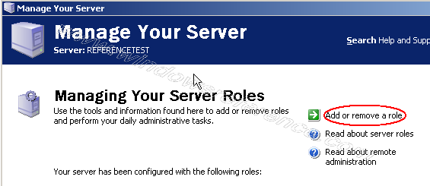
How to Configure the Mail server ?
First you need to make sure you have install and configure windows server 2003 with domain controller.
Install the Email Server
Go to Start->Programs->Administrative Tools->Manage Your Server once it opens you should see similar to the following screen here Click on Add or remove a role

Slide 8
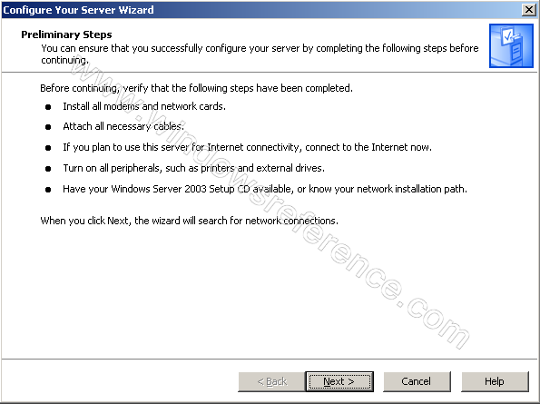
This will start the Configure Your Server Wizard. Read the text and make sure you have connected all the necessary cables and all the other things it says you should do before continuing.Click on Next
We now come to the step where we add and remove roles for our server. Select Mail Server (POP3,SMTP) click Next

Slide 9
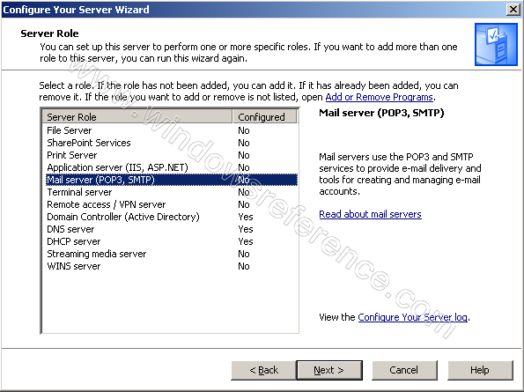
You will now specify the type of authentication and type the email domain name. In this tutorial we will use Windows Authentication, and we will use our domain name, windowsreference.com. You should of course use your domain name.click next

Slide 10
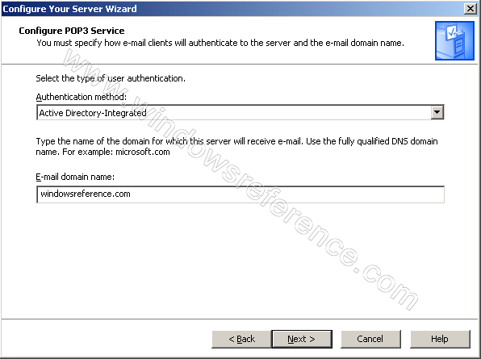
Next step shows summary of our selection click on next

Slide 11
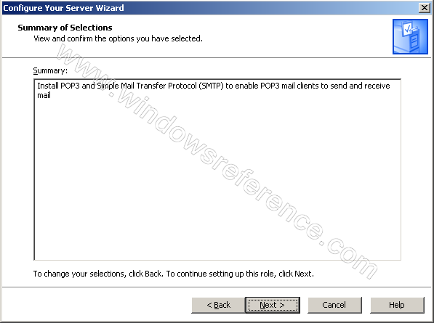
Mail server is in progress

Slide 12
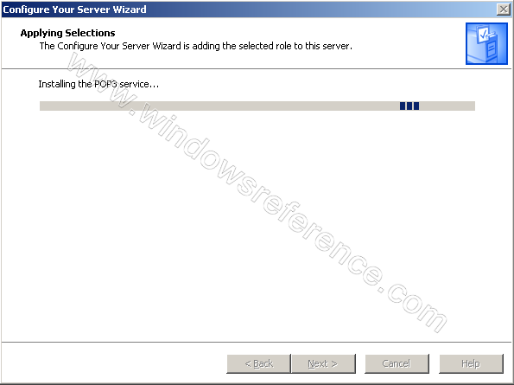
When you get prompted to insert your Windows Server 2003 CD-ROM into your CD-ROM drive, do so and click ok. If you didn’t get prompted to do that, you maybe already have it in the drive.

Slide 13
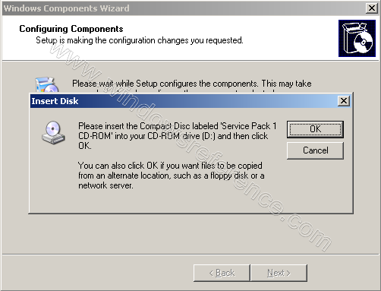
Copying files in progress

Slide 14
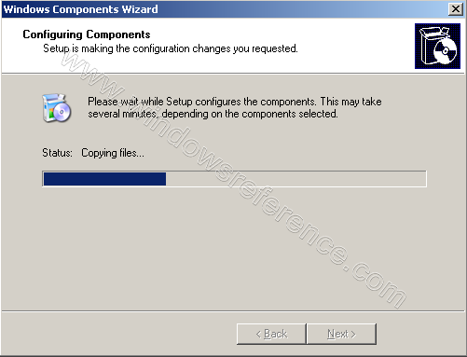
After completing installation you should see similar to the following screen click Finish

Slide 15
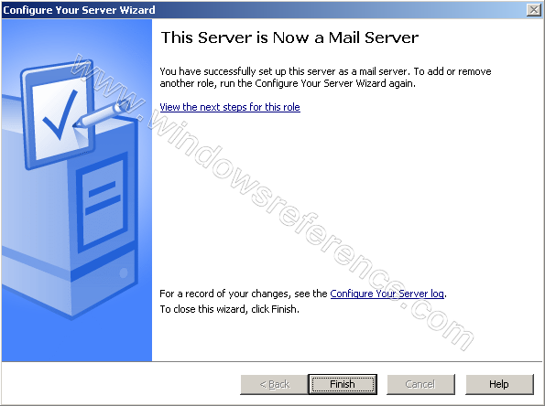

Slide 16
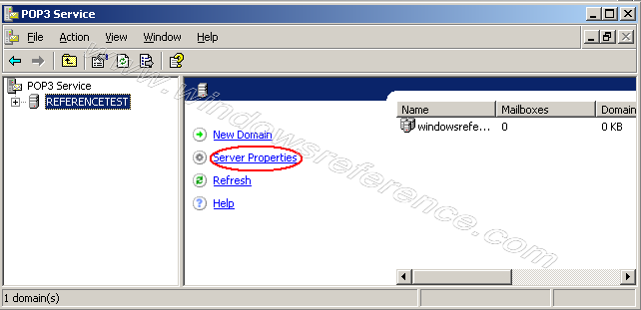
Configuring Email Server
Click Start—>run type server.msc click ok this will open up the POP3 Service. This is where you configure and manage the POP3 part of the mail server. Click on <Computer Name> in the left pane and Click on Server Properties in the right pane
This brings up the Properties for our Mail Server. I will explain each setting as follows

Slide 17
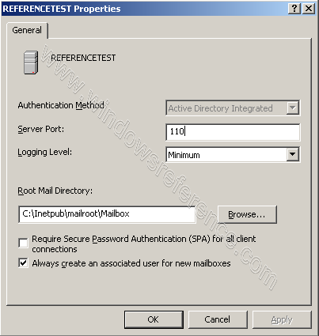
Server Port
We strongly recommend that you use port 110 because this is the standard port for the POP3 protocol. If you change this, make sure you notify all users so they can configure their email clients to use this other port. Also make sure you restart the POP3 service if you change this.

Slide 18
SPA
Enable SPA if you want to have a secure communication between your email sever and email clients. This will send both the user name and password encrypted from the client to the server, instead of sending it in clear text. SPA supports only Local Windows Accounts and Active Directory Integrated Authentication. It is recommended to use this. Remember to restart the POP3 service if you change this

Slide 19
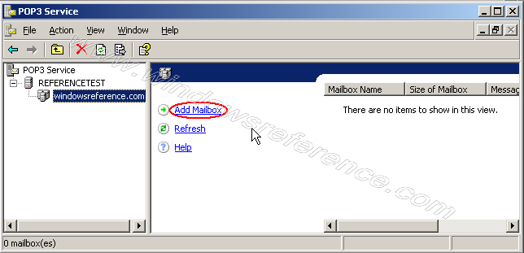
Create a mailbox
The Setup Wizard created a domain to us, so we do not need to create this manually. If you did not use Manage Your Server to install, add the domain manually be clicking the server name in the left pane and then click New domain in the right pane.
Remember to set the properties before you add the domain.(We have completed in the above step)
Click on your domain (windowsreference.com in my case) in the left pane.Click Add Mailbox in the right pane.
This will open up the Add Mailbox window here you need to enter name and password click ok

Slide 20
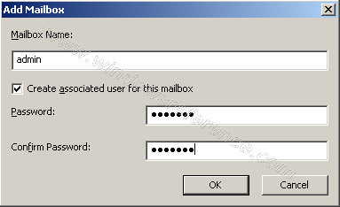
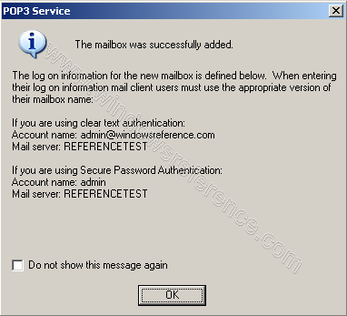
A message will pop-up and tell you how to configure the email clients. Read this, and notice the difference when using SPA or not. click ok
After creating user you should see similar to the following screen

Slide 21
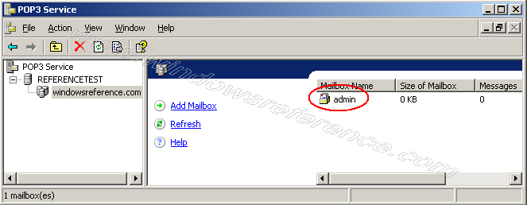
What we just did was not only creating a mailbox named admin, but we also created a user admin.

Slide 22
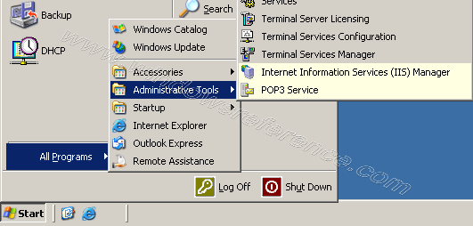
How to Configure the SMTP Server?
Open Computer Management ,Expand Services and Applications, expand Internet Information Service Right click Default SMTP Virtual Server and click Properties

Slide 23
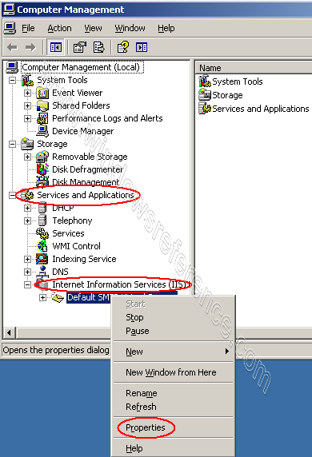
Once it opens properties tab you should see similar to the following screen here you need to Click the Access tab Click the Authentication button

Slide 24
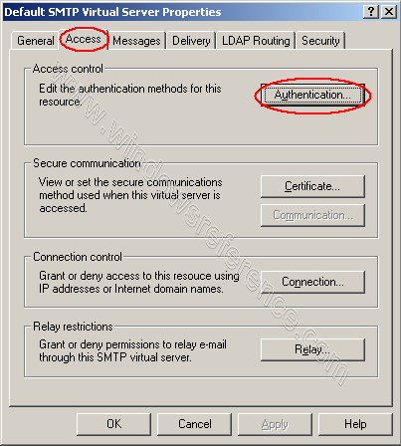
Here you need to make sure Anonymous Access and Integrated Windows Authentication is enabled.

Slide 25
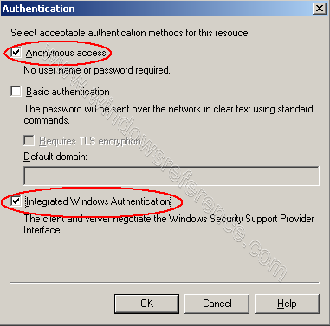
Click the Relay button from the properties windows and make sure Allow all computers which successfully… is enabled and Only the list below is selected.

Slide 26
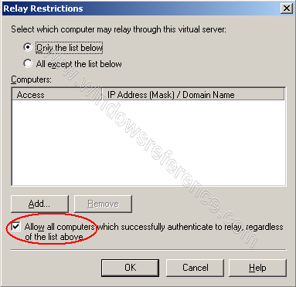
First of all, Authentication and Relay is not the same thing. We use the Authentication button to specify which authentications methods are allowed for users and other SMTP servers.

Slide 27
.
Enable SPA (Secure Password Authentication)
You need to configure your network network as secure as possible, so we prefer to use SPA (Secure Password Authentication). This will, as stated before, send the user name and password from the client encrypted, instead of clear text.
Click Start, then Run ype p3server.msc
In the right pane, right click your computer’s name and click Properties
Check the box Require Secure Password Authentication… and Click OK

Slide 28
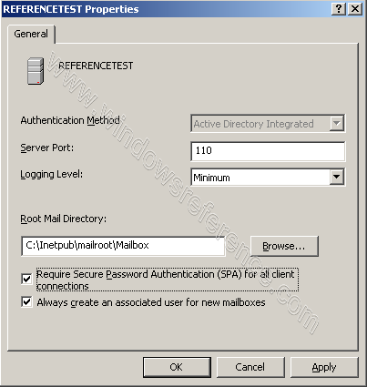
You will be prompted to restart the Microsoft POP3 Service, click Yes

Slide 29


Slide 30
The Process of Sending an Email
Now that you know the basics about incoming and outgoing mail servers, it will be easier to understand the role that they play in the emailing process. The basic steps of this process are outlined below for your convenience.
1: After composing a message and hitting send, your email client - whether it's Outlook Express or Gmail - connects to your domain's SMTP server. This server can be named many things; a standard example would be smtp.example.com.

Slide 31
2: Your email client communicates with the SMTP server, giving it your email address, the recipient's email address, the message body and any attachments.
3: The SMTP server processes the recipient's email address - especially its domain. If the domain name is the same as the sender's, the message is routed directly over to the domain's POP3 or IMAP server - no routing between servers is needed. If the domain is different, though, the SMTP server will have to communicate with the other domain's server.
4: In order to find the recipient's server, the sender's SMTP server has to communicate with the DNS, or Domain Name Server. The DNS takes the recipient's email domain name and translates it into an IP address. The sender's SMTP server cannot route an email properly with a domain name alone; an IP address is a unique number that is assigned to every computer that is connected to the Internet. By knowing this information, an outgoing mail server can perform its work more efficiently.

Slide 32
4: In order to find the recipient's server, the sender's SMTP server has to communicate with the DNS, or Domain Name Server. The DNS takes the recipient's email domain name and translates it into an IP address. The sender's SMTP server cannot route an email properly with a domain name alone; an IP address is a unique number that is assigned to every computer that is connected to the Internet. By knowing this information, an outgoing mail server can perform its work more efficiently.
5: Now that the SMTP server has the recipient's IP address, it can connect to its SMTP server. This isn't usually done directly, though; instead, the message is routed along a series of unrelated SMTP servers until it arrives at its destination.

Slide 33
6: The recipient's SMTP server scans the incoming message. If it recognizes the domain and the user name, it forwards the message along to the domain's POP3 or IMAP server. From there, it is placed in a send mail queue until the recipient's email client allows it to be downloaded. At that point, the message can be read by the recipient.
How Email Clients are Handled
Many people use web-based email clients, like Yahoo Mail and Gmail. Those who require a lot more space - especially businesses - often have to invest in their own servers. That means that they also have to have a way of receiving and transmitting emails, which means that they need to set up their own mail servers. To that end, programs like Postfix and Microsoft Exchange are two of the most popular options. Such programs facilitate the preceding process behind the scenes. Those who send and receive messages across those mail servers, of course, generally only see the "send" and "receive" parts of the process.

Slide 34
6: The recipient's SMTP server scans the incoming message. If it recognizes the domain and the user name, it forwards the message along to the domain's POP3 or IMAP server. From there, it is placed in a send mail queue until the recipient's email client allows it to be downloaded. At that point, the message can be read by the recipient.

Slide 35
How Email Clients are Handled
Many people use web-based email clients, like Yahoo Mail and Gmail. Those who require a lot more space - especially businesses - often have to invest in their own servers. That means that they also have to have a way of receiving and transmitting emails, which means that they need to set up their own mail servers. To that end, programs like Postfix and Microsoft Exchange are two of the most popular options. Such programs facilitate the preceding process behind the scenes. Those who send and receive messages across those mail servers, of course, generally only see the "send" and "receive" parts of the process.

Slide 36
conclusion
The important of configuring mail sever is to enable the users to send and receive mail message in their organization or company

